Slide 1
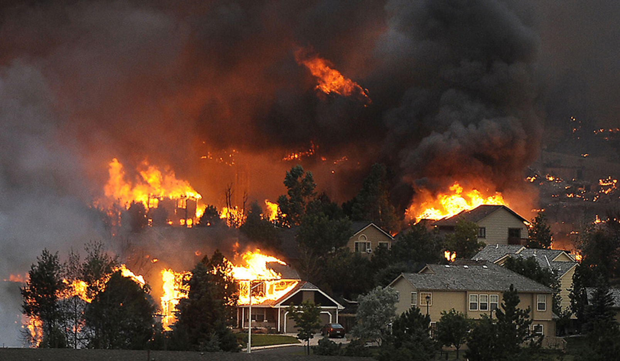
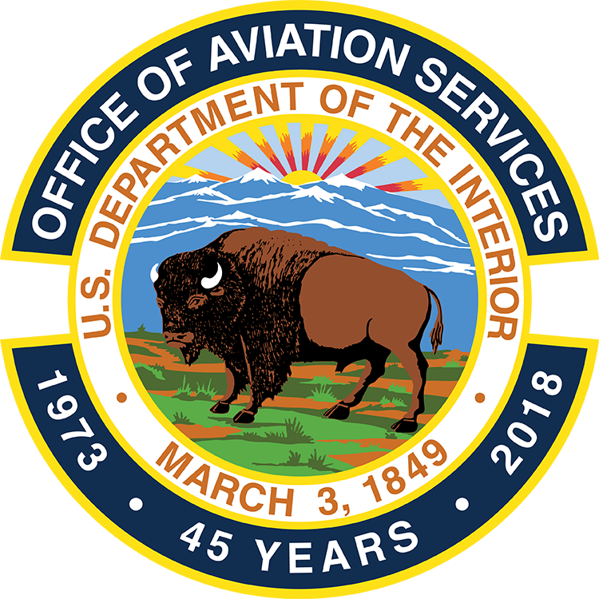
Optionally Piloted Helicopters
A Game-Changing
Interior Leadership Opportunity
in Wildland Fire
Mark Bathrick
Director
Office of Aviation Services (OAS)
Boise, Idaho
May 13, 2019 https://www.doi.gov/aviation/uas
Notes:
Mark Bathrick Intro:
Over 30 years of technical, acquisition, program management, and operational experience in UAS.
Retired Navy CAPTAIN, a TOPGUN trained and combat-experienced Navy TOMCAT pilot. Graduate of the prestigious Empire Test Pilots’ School in the UK (Navy only sends the top test pilot school candidate to this school each year). Two squadron commands including Chief Test Pilot and commander of a Navy Flight Test Squadron with 19 Optionally Piloted Aircraft; received the Presidential award for the best base in the Navy in command of a major installation.
Worked for the Chief of Naval Operations and Chairman, Joint Chiefs of Staff, Colin Powell in the Pentagon in high level finance and budget positions.
4 years of land management experience as commanding officer of a 7,400 acre Navy base and leader of a regional collaborative wildland fire team consisting of two counties, three military bases, and five local towns. Responsible for coordinating and implementing hazardous fuels treatment, preparedness, and inter-governmental agreements for firefighting mutual aid across >100K acres.
13 years as an SES, serving as Director of the Office of Aviation Services and the visionary architect of Interior’s award-winning UAS program. Recipient of the Commercial Drone Alliance’s 2017 “Industry Heroes, End-User Innovator Award. Selected by Commercial UAV News as one of the Top 7 Drone Visionaries in Commercial Markets (2018). Selected as a 2018 finalist for the Partnership for Public Service’s Samuel J Heyman Service to America Medal for having successfully developed the largest, most respected non-military UAS program with no zero additional funding or personnel.
Under Mark’s leadership and implementation of international industry quality management practices, OAS is currently managing 54% more aviation contracts, 540% more fleet aircraft, 400% more fleet pilots, and supporting 21% more bureau aviation units, with 3% fewer people and 21% less inflation adjusted funding than in 2007.
Mark’s 8 slides will take about 17 minutes to go through, which will allow plenty of time for questions and discussion, so I’d ask that you please hold your questions until the end.

Slide 2


Overview
The President and the Secretary have taken a leadership position in active management of vegetation to reduce the risk of wildfire….but,
……we still fight fire from the air “the way we’ve always done it.”
Interior’s leadership opportunity – Pick up and run with the ball dropped by the last administration from 2014 - 2016.
  Leverage DOD-developed/proven technology investment to triple the opportunity for initial and extended suppression of wildfires, likely saving hundreds of millions.
  Meet and exceed EO, SO, and Congressional direction.
Notes:
The President and the Department have taken a leadership position in active management of vegetation to reduce the risk of wildfire…….but,
We still fight fire “the way we’ve always done it.” …………..like reducing the risk of fire around your house, but not upgrading your fire department.
Interior’s leadership opportunity – Leverage DOD-developed/proven technology investment to triple the opportunity for initial and extended suppression of wildfires, likely saving hundreds of millions.
Good government – Interagency collaboration – Innovation

Slide 3
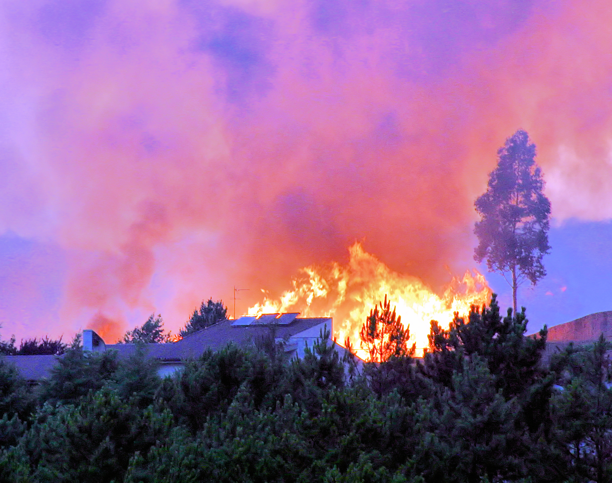

Wildfire 2018 – The WAR on the Home Front
58,000+ wildfire starts.
~9 million acres burned.
>25,000 homes, businesses destroyed.
>$3 billion in suppression costs. Total economic loss is 5 - 50X higher.
Increasing civilian deaths – 97 in CA alone; 19 firefighters nationwide.
Annually, more Americans are directly threatened by wildfire than by war or terrorism.
MLB18
Notes:
Fire is a natural part of our ecosystem, but………that doesn’t extend to the loss of human life, homes and businesses.
When I retired from the Navy, I thought my direct involvement with war was over, but I soon learned, I was wrong. Every year, there is an increasingly costly WAR on the Homefront, a war that we must address in new and innovative ways if we are to win this war and reduce the annual human, material, and economic loss that results.
58,000+ wildfire starts.
~9 million acres burned.
$3 billion in suppression costs. Total economic loss is 5-50X higher.
Increasing direct civilian deaths – 104 in CA alone.
>25,000 homes, businesses destroyed.
Annually, more Americans are threatened by wildfire than by war or terrorism.

Slide 4
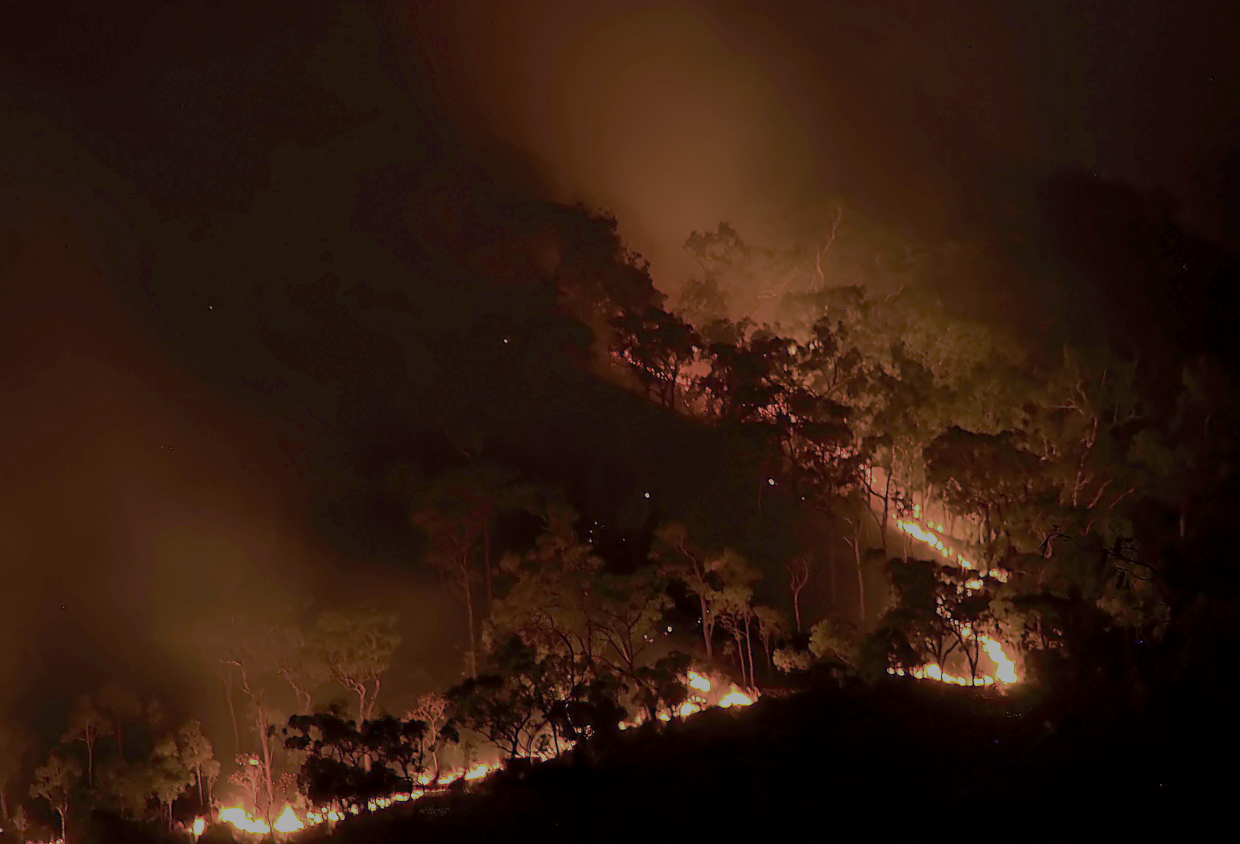
Fire aviation War report
Since 1930, “The Way We’ve Always Done It”
Only capable ~8 hours each day (1/3rd).
  Initial & extended attack.
  Aerial resupply.
  Emergency extraction.
Smoke grounds aircraft for days.
20% - 50% of all wildfires discovered outside aviation coverage.
  In 2018, of California’s 10 most destructive wildfires, half were ignited in darkness, or more than an hour before pilots were scheduled to begin operations, according to state fire data.
Current drones “observe” but don’t “fight.”
No outcome effectiveness measures = no credible planning factors.
Aggressive risk reduction not matched with initiatives to improve effectiveness.
MLB18
Notes:
The 2018 “WAR” Report.
In 2018, there were about 58,000 separate wildfire starts, an average number for a typical year.
However, 2018 was an extraordinarily costly year for fire with about 9M acres burned and over $3B spent on efforts to suppress these fires (does not include the Preparedness costs to equip and train to fight the fires, the Emergency Stabilization and Burned Area Rehabilitation costs after the fire, or the long term economic loss that results from wildfires).
Despite this, we continue to fight fire as we have done for a lifetime of years. Today, as in 1930 when aviation was first used to deliver suppressants and retardant, aviation only supports our ground firefighters 8 of 24 hours each day.
In 2018, as in previous years, the time aviation was unable to support our firefighters was often extended as lingering smoke grounded all manned aviation for days at a time.
Another factor that hinders our ability to keep wildfires from growing into the few large ones that consume the vast majority of funds and cause the most loss is the fact that 20%-50% of all wildfires are discovered outside traditional aviation coverage hours, allowing these wildfires to burn untreated for up to 16 hours……imagine if your house were on fire, but the fire department was unable to attack the fire until up to 16 hours after it started?
Another fact that limits our ability to win individual battles in this war is the fact that maps of the fire area and intel related to fire behavior is often 18-24 hours old, obtained from a severely limited (2) number of infrared mapping aircraft that are available.
Finally, as was the case in 1930, when water was first dropped from an aircraft on a wildfire, we still have NO outcome measures for the effectiveness of water or retardant drops on wildfires.
However, drones provide us with the ability to “leap-frog” the historic and current pace of improvements and change the game, giving Incident Commanders the upper hand in this War.
Current UAS “observe” but don’t “fight.”
No outcome effectiveness measures = no credible planning factors.
Aggressive wildfire risk reduction not matched with initiatives to improve fighting effectiveness.

Slide 5
Optionally Piloted Airplanes / Helicopters (OPA / OPH)
Defined – Can be piloted either from the cockpit or remotely.
Add on capability – not new aircraft.
First used in WWII – Operations Aphrodite & Anvil (B-17, PB4Y).
Continued use - F6F, F-86, F-100, F-102, F-104, F-106, F-4, F-16.
2010 - $45.8M contract – K-MAX firefighting helicopter kitted to OPH.
2011 – 2014: USMC K-MAX OPH deployed to Afghanistan – 1,000’s of flights, mostly at night, 4.5M lbs. of cargo @ $1,300 / hour
Safer than small drones - redundant systems, electronic ID, easy to see.
Secure – military-grade encryption.
Notes:
Defined – Can be piloted from the cockpit or remotely.
First use: WWII – Operations Aphrodite and Anvil (B-17, PB4Y).
F6F Hellcat, F-86, F-100, F-102, F-104, F-106, F-4, F-16.
2010 - $45.8M Navy contract – K-MAX firefighting helicopter kitted to OPH.
2011 – 2014: USMC K-MAX OPH deployed to Afghanistan – 1,000’s of flights, mostly at night, 4.5 million lbs. of cargo @ $1,300 / hour.
Safer than small drones - redundant systems, electronic ID, easy to see.
Secure – military-grade encryption

Slide 6

OPH in Wildland Firefighting – No “Paper Drill”
2014 – Interagency Unmanned Aircraft Tech Demo Plan signed (USFS, OWF, Fire bureaus, DAS PRE, OAS).
2014 – OAS-led, industry funded demo @ FAA Test Site.
2015 – OAS-led, industry funded demo @ Boise.
All Demo Plan exit criteria met.
2015 - $10M est. to complete integration/field.
Previous administration: stay with “the way we’ve always done it.”
2012 USFS-funded RAND Study: “….about 80 percent of historical fires have been within 5 miles of a helicopter- accessible body of water.”
Notes:
2014 – Interagency Unmanned Aircraft Tech Demo Plan signed (USFS, OWF, Fire bureaus, DAS PRE, OAS).
2014 – OAS-led, industry funded demo @ NYS FAA UAS Test Site.
2015 – OAS-led, industry funded demo @ Boise, ID.
Safer than small drones: redundant systems, electronic ID, easy to see.
Secure – Military-grade encryption precludes “hacking.”
All documented Tech Demo Plan exit criteria met.
Previous administration decided to stick with “the way we’ve always done it.”
NOTE: VIDEO COMPILATION OF 2014 & 2015 LIVE FLIGHT DEMONSTRATIONS – 2 minutes, 27 seconds.

Slide 7
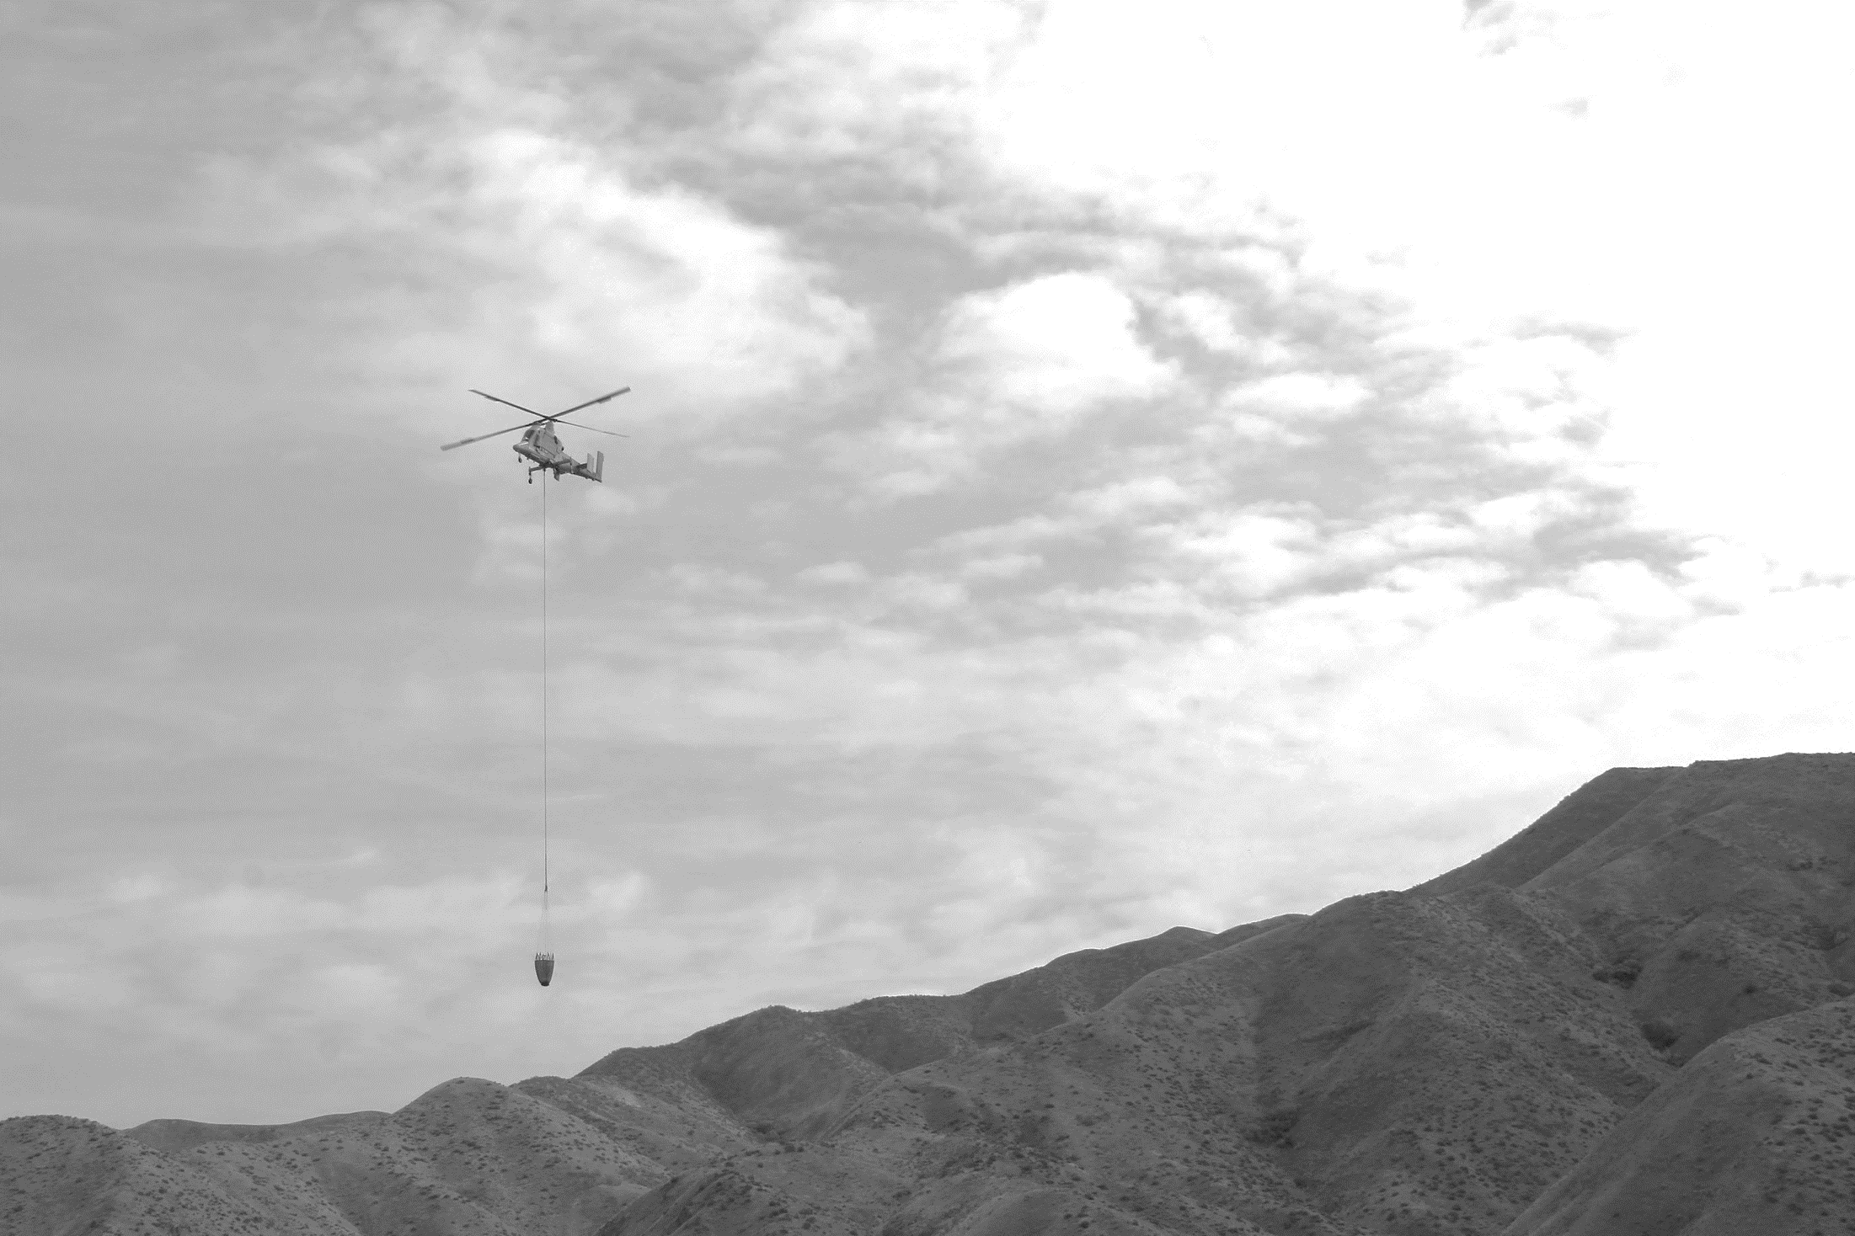
The Potential of Optionally Piloted Helicopters
Initial & Extended Coverage
Closes
Historic Gaps in Aerial Wildfire Support
Outcome Measures
Leverages
Proven Military Technology
Supports Aggressive Wildland Firefighting*
Safer & More Secure Than Small Drones
Improved Contract Use, No Additional Contracts or Aircraft
Optionally Piloted Helicopters
Creates Jobs
Easily Repositioned in Conventional Mode
Contract Vendor Industry Benefits
Wind
Temp
Rh
Piloted Helicopter
Day Use Untouched
*May 10, 2019 – CA announces Wildfire X-Prize competition.
Notes:
No new contracts/aircraft required – “kitted” aircraft, added line item.
No integration issues – conventionally piloted in clear day, fly remotely during uncovered 16 hrs
First-ever 24/7 initial attack, triples current extended attack coverage.
Largely incremental cost increase – addtl pilot, additional flight hours.
Creates Jobs.
Already part of a signed interagency integration plan.

Slide 8

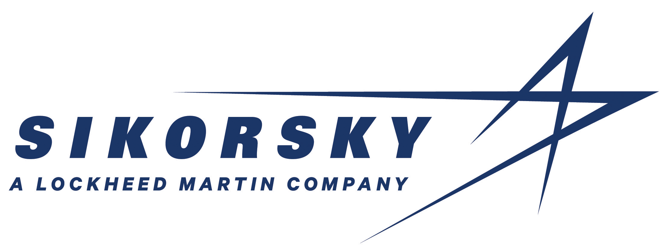


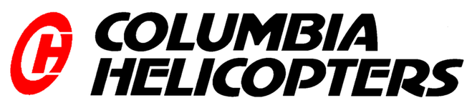
Interior Management Considerations
EO 13855 (Sec. 4 – “max appropriate use of UAS”) & SO 3372 (Sec 4, (2) b. iii. – “UAS to suppress”).
John D. Dingell, Jr. Conservation, Management, and Recreation Act, SEC. 1114. Wildfire Technology Modernization - “assess unmanned aircraft system technologies, including optionally piloted aircraft, across the full range of wildland fire management operations in order to accelerate the deployment and integration of those technologies into the operations”
Increased Taxpayer Value – leveraging ~$130M DOD investment.
Pro-Business, Pro-Technology.
Aligns with Administration’s “Make It Great, Not the Way We’ve Always Done It” philosophy. If 3X coverage = only a 10% reduction, then $300M & 900K acres saved ANNUALLY.
Notes:
EO 13855 (Sec. 4 – “max appropriate use of UAS”) & SO 3372 (Sec 4, (2) b. iii. – “UAS to suppress”).
John D. Dingell, Jr. Conservation, Management, and Recreation Act, SEC. 1114. Wildfire Technology Modernization - “assess unmanned aircraft system technologies, including optionally piloted aircraft, across the full range of wildland fire management operations in order to accelerate the deployment and integration of those technologies into the operations”
Increased Taxpayer Value – leveraging ~$130M DOD investment.
Pro-Business, Pro-Technology. KAMA, BOEING (w/COLUMBIA HELICOPTERS), & SIKORSKY (part of Lockheed Martin) are ALL pursuing OPH technology with potential firefighting applications.
Aligns with Administration’s “Make it Great, Not the Way We’ve Always Done It” philosophy. If 3X coverage = only 10% reduction, then $300M & 900K acres saved ANNUALLY!

Slide 9
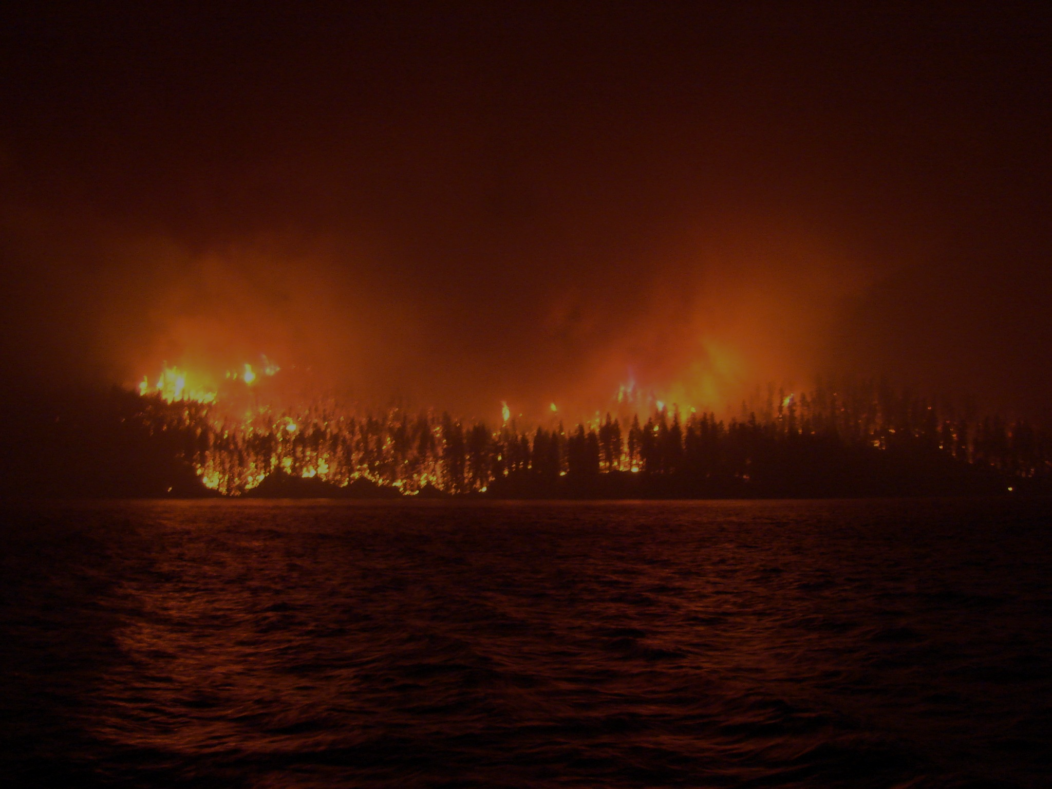
Conclusions
Actively reducing wildfire risk, while fighting it “as we’ve always done it” is only 1/2 a strategy.
89 years and billions spent on aerial suppression with NO outcome effectiveness measures is unconscionable to continue.
OPH has demonstrated the potential to address.
VLAT & UAS Call-When-Needed contract lessons: if you build and field it, they will use it and later demand it.

Slide 10
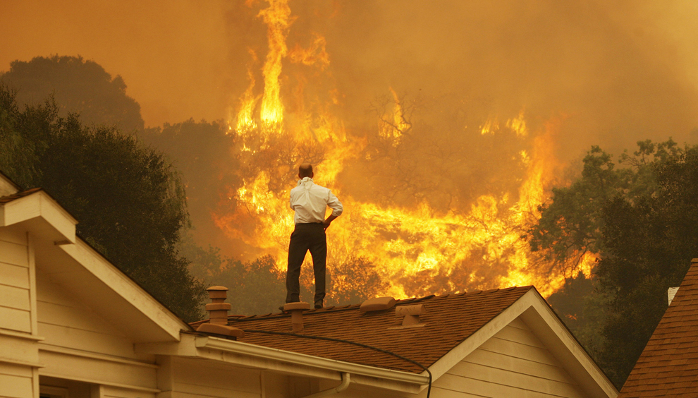
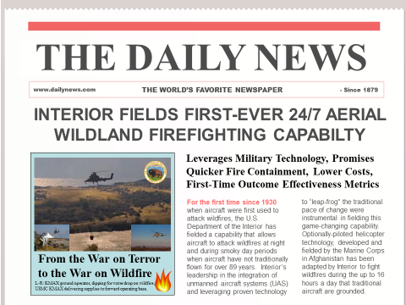
Optionally Piloted Helicopters
Discussion
Mark Bathrick
Director
Office of Aviation Services (OAS)
Boise, Idaho
https://www.doi.gov/aviation/uas

