Slide 1
An Overview of the Revised 508 Standards – & A Roadmap for Transitioning

Slide 2
Agenda
The Revised 508 Standards – What is changing
What government resources are available
Questions & Answers

Slide 3
Changes
Standards changes having greatest impact on implementation strategies
From product based to feature based approach
New organizational approach
New scoping requirements
Changing exception requirements
New standards for electronic content, software, and hardware
Major emphasis on WCAG for electronic content and software
NOTE: these are just highlights – not intended to be an exhaustive list!

Slide 4
Information & Communications Technology (ICT)
Information technology and other equipment, systems, technologies, or processes
for which the principal function is the creation, manipulation, storage, display, receipt, or transmission of electronic data and information
as well as any associated content.

Slide 5
New organizational approach
Original 508 Standards
General
Technical Standards
1194.21 Software applications and operating systems.
1194.22 Web-based intranet and internet information and applications.
1194.23 Telecommunications products.
1194.24 Video and multimedia products.
1194.25 Self contained, closed products.
1194.26 Desktop and portable computers.
1194.31 Functional performance criteria.
1194.41 Information, documentation, and support.
Revised 508 Standards
Chapter 1: Application and Administration
E101 General E102 Referenced Standards E103 Definitions Chapter 2: Scoping Requirements
(includes WCAG applicability to electronic content and software)
Chapter 3: Functional Performance Criteria
Chapter 4: Hardware
Chapter 5: Software
Chapter 6: Support Documentation & Services

Slide 6
Standards categories
Electronic Content
Software
Hardware
Support Services & Documentation

Slide 7
Electronic Content Examples
Websites and web-based content (Internet & Intranet)
Microsoft Office & PDF Documents
Training materials (e.g., online training materials, tests, online surveys)
Multimedia (video/audio)
Digital content (e.g., documents, templates, forms, reports, surveys)
Interactive maps
Electronic emergency notifications
Subscription services (e.g., news feeds, alert services, professional journals)

Slide 8
Public Facing vs. Non Public Facing
Public Facing | Non Public Facing
Made available to members of the general public | May be broadly disseminated or sent to individual agency employees May be sent to or made available to specific members of the public
Usually published on the web (for example, on an agency website, blog, form, or social media page) However, public facing content might also be made available in non-web formats, such as information displayed on screens or interactive kiosks in waiting areas | Content may be disseminated via an internal agency website or intranet, or by other delivery modes Common distribution methods: email, text messages, phone alerts, storage media and downloadable documents
Applies to ALL electronic content | Applies to nine categories of electronic content

Slide 9
The “Nine Categories”
An emergency notification
An initial or final decision adjudicating an administrative claim or proceeding.
An internal or external program or policy announcement.
A notice of benefits, program eligibility, employment opportunity, or personnel action.
A formal acknowledgement of receipt.
A survey or questionnaire:
A template or form
Educational or training materials
Intranet content designed as a Web page
Note: Section 504 accommodation requirements always apply

Slide 10
Electronic Content Examples
Web, desktop, server and mobile applications
Authoring Tools & Platforms
Software Infrastructure
ICT Service offerings (e.g. “as a service”

Slide 11
Hardware Examples
Computers & Laptops
Servers
Tablets
Printers
Copiers
Document Scanners
Multi-function office machines
Peripheral equipment (e.g., keyboards, mice)
Information kiosks and transaction machines
Mobile phones

Slide 12
Support Services & Documentation
Accessibility and Compatibility Features
WCAG conformance
Alternative formats
Accommodate PWDs

Slide 13
Revised Functional Performance Criteria
Applicability
Where the requirements in Chapters 4 (Hardware) and 5 (Software) do not address one or more functions of ICT
Covers
No vision, limited vision, color blindness
No hearing and limited hearing
No speech
Limited manipulation, limited reach & strength,
Limited language, cognitive and learning abilities

Slide 14
Major changes to exceptions
Exceptions apply features & components
New Exceptions
Legacy ICT
Best Meets
Narrower Scope
Undue Burden
Back Office (Now called ICT in Maintenance and Monitoring Spaces)

Slide 15
What standards apply to electronic content and software?

Slide 16
WCAG Conformance A & AA
Applies to all electronic content & software
Must reach Level A and AA to conform to Revised 508 Standards

Slide 17
Standards Applicability to Electronic Content
Web:
All WCAG A & AA
Success Criteria
Non Web:
4 WCAG Exclusions
Support Documentation & Services Standards
(when these are provided)
+

Slide 18
Standards Applicability to Software
Web:
All WCAG A & AA
Success Criteria
Non Web:
4 WCAG Exclusions
Support Documentation & Services Standards
Software Standards
Functional Performance Criteria
+
+

Slide 19
Agenda – Part 2
The Revised 508 Standards – What is changing
What government resources are available
Questions & Answers

Slide 20
Inter-Agency 508 Refresh Workgroup

Slide 21
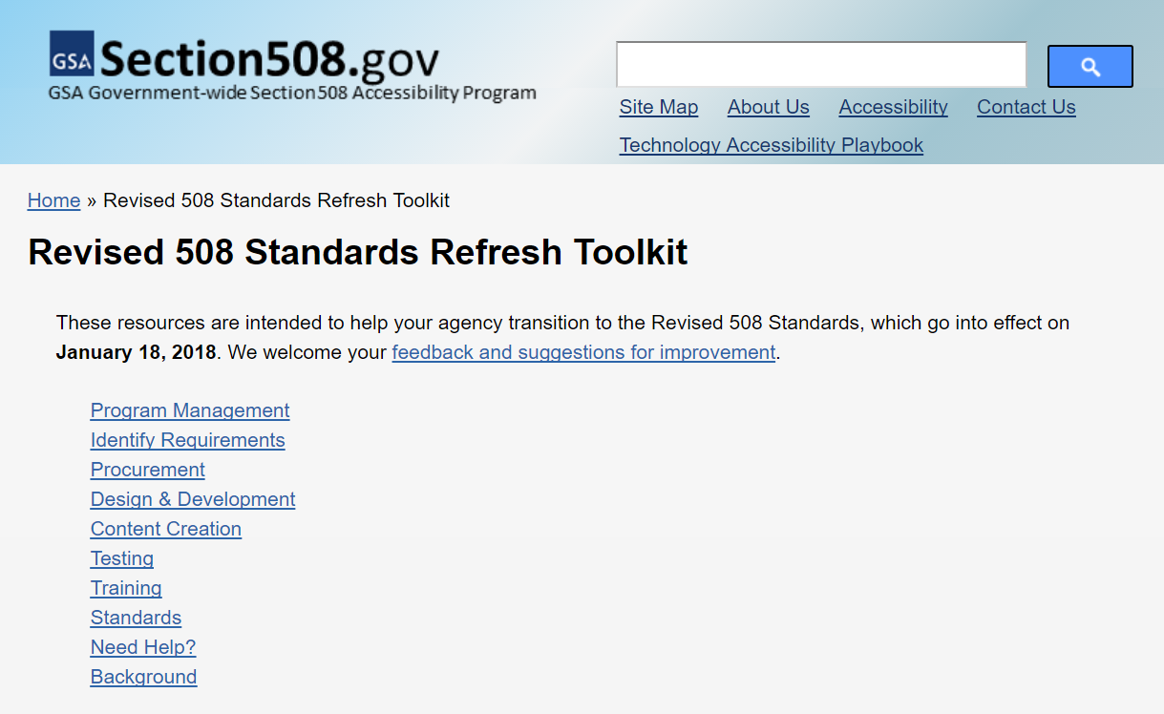
Revised 508 Standards Refresh Toolkit

Slide 22
https://www.section508.gov/refresh-toolkit

Slide 23
Where do I begin?
Resource | Purpose
Overview of the New Standards | High level overview all changes from the Original 508 Standards
Cross reference tables for web, software and hardware | Detailed provision by provision comparison between the original and revised standards
Quick Reference Guide | High-level recap of what agencies need to change – and links to available resources

Slide 24
508 Program Resources
Resource | Purpose
Revised 508 Standards Roadmap | How to manage your 508/IT Accessibility Program in accordance with the Revised 508 Standards
Transition Quick Reference Guide | High-level recap of what your agency needs to change, based on revisions to the Standards
Old vs. Revised Standards Comparison charts | Detailed standard by standard comparison
How to Update Agency Policies for the Revised 508 Standards | Identifies key policy areas that are impacted by changes in the Revised 508 Standards, Provides high level policy guidance Provides sample policy language
How to Identify User Needs | Learn how to identify user needs for IT accessibility
Building Organizational Support for Accessible Electronic Content | Help your staff get the tools and training they need to produce accessible electronic content

Slide 25
How to identify Section 508 Requirements
Resource | Purpose
Section 508 Applicability Checklist & Instructions | Step by step guidance on how to develop accessibility requirements
Application 508 Standards and Exceptions Chart | Sample template for reporting standards and exceptions in solicitations
Accessibility Requirements Tool (ART) | GSA replacement for Buy Accessible Wizard Based on Revised 508 Standards Applicability Checklist for consistency Generates very detailed applicability reports, and eventually tailored contract language

Slide 26
How to procure ICT using the Revised 508 Standards
Resource | Purpose
How to Request Information From Vendors | Detailed recommendations on how to obtain higher quality 508 information from vendors
How to Define Accessibility Provisions Clauses and Acceptance Criteria | Provides detailed recommendations on recommended provisions and clauses to proactive protect agency risk
Accessibility Conformance Reports (based on VPAT 2.0 Template) | An entirely new template for vendors to report on product conformance to the Revised 508 Standards.
Solicitation Requirements Tool (SRT) | Uses machine learning to automatically review ICT solicitations and identify potential need for 508 review to ensure proper 508 language is included.

Slide 27
How to design & develop ICT using the Revised 508 Standards
Resource | Purpose
Accessibility Resources for Developers and Authors | Extensive list of resources to help developers and authors create accessible electronic content that conforms the Revised 508 Standards
US Web Design Resources | A design system to quickly prototype and deploy accessible digital products
Guidance on defining requirements | Same as applicability guidance previously mentioned

Slide 28
How to create accessible electronic documents using the Revised 508 Standards
Resource | Description
Microsoft Office 2013 (Word, Excel PowerPoint) | Baseline Test Process Test Checklist
Microsoft 365 (Word, Excel PowerPoint, Outlook) | Same as above
Adobe PDF | Same as above
Microsoft Word and PDF Training Videos | Short 2-5 minute You Tube Training Videos Developed by the FAA

Slide 29
How to test for conformance to the Revised 508 Standards *Update coming FY 2019
Resource | Description
Inter Agency Trusted Tester Baseline | Baseline any agency can use to construct their own test process
DHS Trusted Tester Process V5 | DHS’s test process for web and software
DHS Trusted Tester Training | FAC49: What Is Section 508 and Why Is It Important To You FAC50: Trusted Tester Tools FAC51: Section 508 Standards for Software and Web FTE250: Trusted Tester Training FAC56: Section 508 for COR(s), Program and Project Managers
DHS Trusted Tester Certification Exam | FTE251: Trusted Tester Certification Exam
Electronic document testing resources | Updated resources for testing Microsoft Office and Adobe PDF documents for conformance to the Revised 508 Standards

Slide 30
How to get training on the Revised 508 Standards
Resource | Purpose
Section 508: What is It and Why is It Important to You? | Introduction to Section 508 and Information and Communication Technology (ICT).
Accessibility of ICT: An Overview for Government Executives | A brief, high-level overview of the Revised 508 Standards, including roles and responsibilities of key Federal agency officials.
Procuring Section 508 Conformant ICT Products and Services | Basic overview of the Federal acquisition process with regard to procuring ICT products and services that are Section 508 conformant.
Accessibility of ICT: Micro-Purchases | How to make micro-purchases that conform with the Revised 508 Standards.
Technology Accessibility Playbook: How to Build an Effective Section 508 Program | Describes the 12 plays to integrate strategic, business and technology management into a successful Section 508 program, to ensure Federal ICT is accessible to persons with disabilities.
508 Transition Webinars | This series of webinars

Slide 31
https://www.section508.gov/refresh-toolkit

Slide 32
Agenda – Part 3
The Revised 508 Standards – What is changing
What government resources are available
Questions & Answers

Slide 33
Contact Information
For Technical Assistance with understanding the Revised 508 Standards
U.S. Access Board
(800) 872-2253 (voice)
(800) 993-2822 (TTY)
E-mail: 508@access-board.gov
www.access-board.gov
For Technical Assistance with implementing the Revised 508 Standards
DOI Section 508 Program
202-219-0963 (voice)
800-877-8339 (TTY)
E-mail: Section508@ios.doi.gov
www.doi.gov/OCIO/section508

