Slide 1
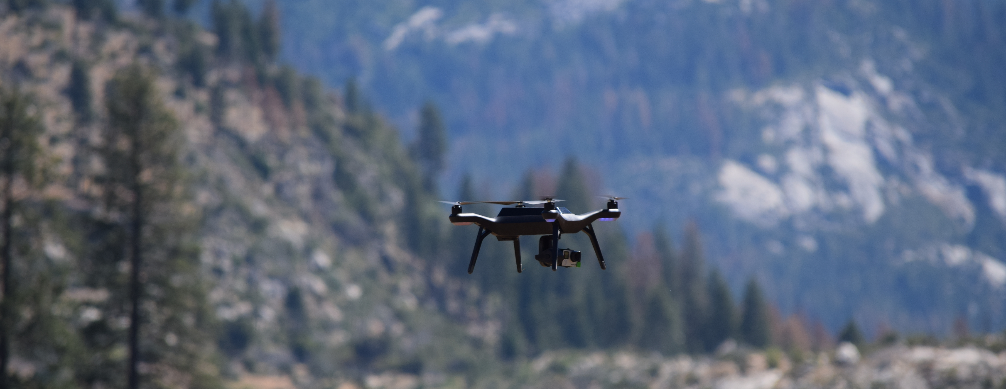

UAS in the Aerial Ignition Mission
Mark Bathrick, Director | Office of Aviation Services
U.S. Department of the Interior
Boise, Idaho
United States of America

Slide 2

Resolution.
Persistence.
Repeatable.
Sensors.
Analytics.
Decisions.
< Air exposure.
< Ground exposure.
Assess hazards (fire, flood, landslide, etc.)
Science
Safety
Acquisition.
Operations.
Maintenance.
Infrastructure.
Training.
Replace labor intensive methods.
Aviation for the masses.
Responsive.
Agile.
Flexible.
Savings
Service
Notes:
Applications
Use the aircraft to supplement or enhance the manned program
Rapidly adopt new sensor technology while trying to standardize as much as possible
Leverage the capability of the platorms to create better products
Reduce the danger to our aviaitors
Build efficiency for our ground personnel (coal min inspectors)
Use the aircraft to support first responders and save lives
Reduce costs in areas where UAS are a better fit than manned aircraft
New class of aircraft will open up new mission that have never been done
Maintain simple, standard pilot training program.

Slide 3
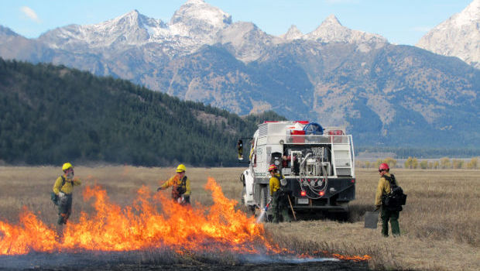
History of Prescribed Fire Operations in the U.S.
Important component of wildland fire management:
  To restore and maintain resilient landscapes
  Safely, effectively respond to wildfires
Ultimate goal: to create fire-resilient landscapes and communities
  Restore fire as a natural occurrence
On average, U.S. Federal wildland fire management agencies perform over 2 million acres of fuels treatments per year (2006 – 2015)
Notes:
Important component of wildland fire and natural resource management
Goal: Create fire-resilient landscapes and communities that can withstand a wildfire without loss of life or property
Restore fire as a natural occurrence across the landscape
On average, (DOI and USFS) perform over 2 million acres of fuels treatments per year

Slide 4
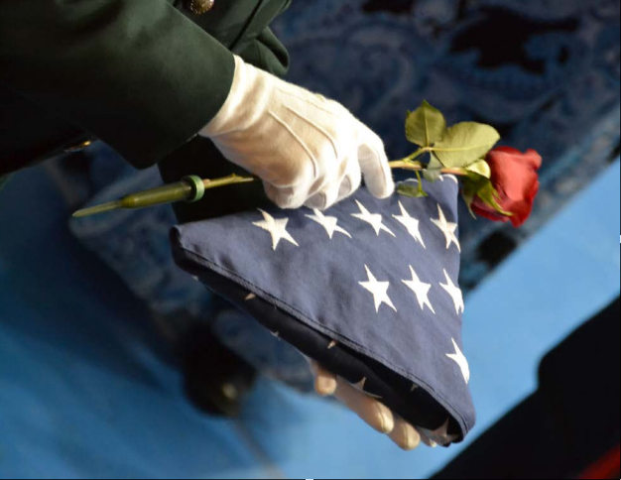
Associated Safety Issues During Prescribed Fire Operations
Since 2005, across the U.S. (all agencies—Federal, tribal, state, and local)
  30 accidents reported
  33 Firefighter injuries
  5 Shelter Deployments
  5 Firefighter fatalities
    3 Aviation related
2016
  Loss of plastic cover from dispenser that impacted tailboom
Notes:
2005 – 2015 Prescribed fire accidents/fatalities (all agencies—Federal, tribal, state, local)
30 accidents reported
33 firefighter injuries
5 fire shelter deployments
5 firefighter fatalities
3 of the 5 aviation related

Slide 5
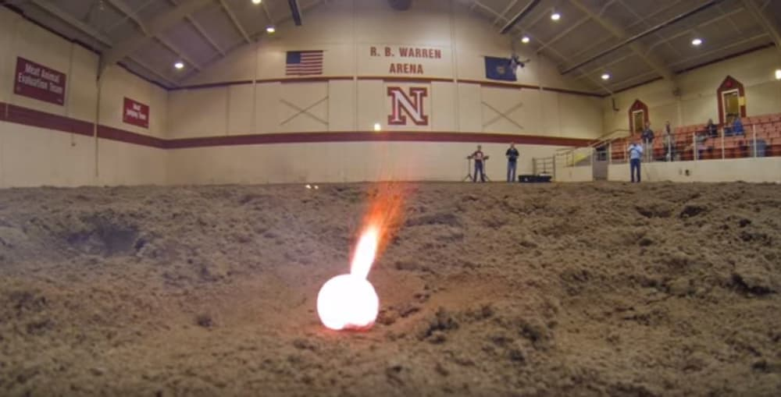
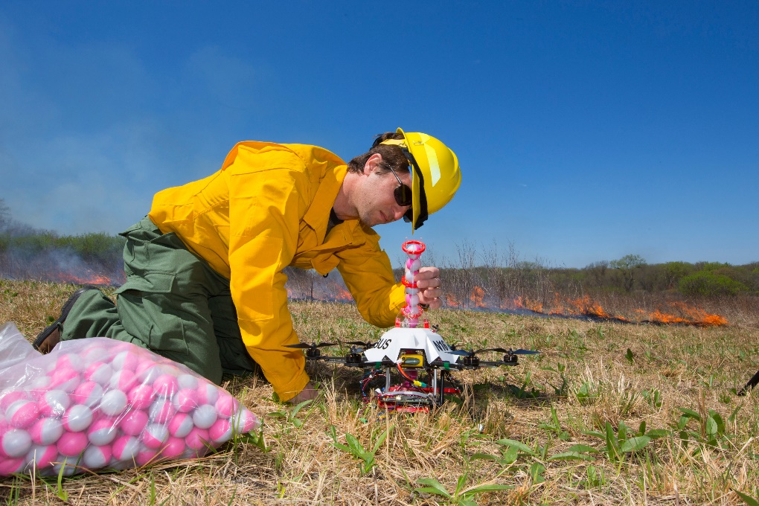
Aerial Ignition Initiative
Collaboration with University of Nebraska-Lincoln
Collaboration with firefighters
Collaboration with Office of Aviation Services
  Satisfied clients or stakeholders
  Met project objectives
  Completed within budget
  Delivered on time
Notes:
Aerial Ignition Initiative
Collaboration with UN-L, firefighters, and OAS
Outcome
Satisfied clients/stakeholders
Met project objectives
Completed within budget
On time

Slide 6
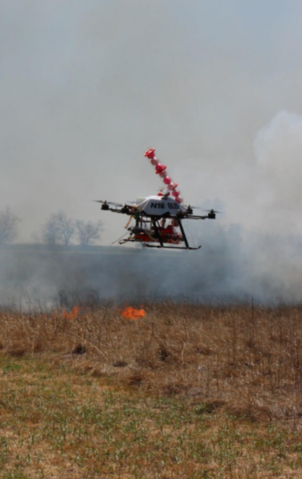
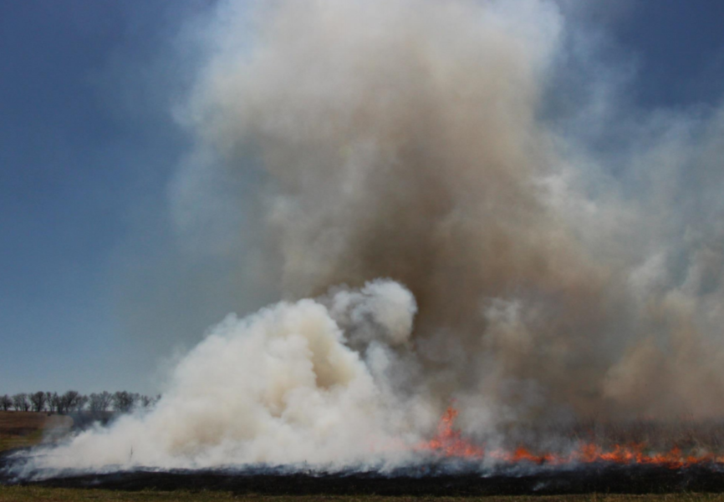
Testing
Homestead National Monument, Nebraska
University of Nebraska-Lincoln
Nebraska Intelligent Mobile Unmanned Systems (NIMBUS) Lab
26 acres of prairie grass.
Location decision
Conditions
Test
Results
Notes:
Testing
Location
Conditions
Test
Results

Slide 7
Testing
March – April 2016.
< 10 mph winds.
No rain.
21 firefighters onsite.
Location decision
Conditions
Test
Results
Notes:
Testing
Location
Conditions
Test
Results

Slide 8
Testing
April 22, 2016, 12:15 – 2:00 PM.
Firefighters ignite E/W flanks.
sUAS complete interior ignition.
Location decision
Conditions
Test
Results
Notes:
Testing
Location
Conditions
Test
Results

Slide 9
Testing
5 flights, ~10 minutes each.
~600’ from launch.
45’ – 75’ AGL
~100 spheres.
Sensors, cameras.
Location decision
Conditions
Test
Results
Notes:
Testing
Location
Conditions
Test
Results

Slide 10
Next Steps
Continued Development
Possible Industry Collaboration
Possible Licensing of Technology
Notes:
Next Steps
Continued development
Possible industry collaboration
Possible Licensing of Technology

Slide 11
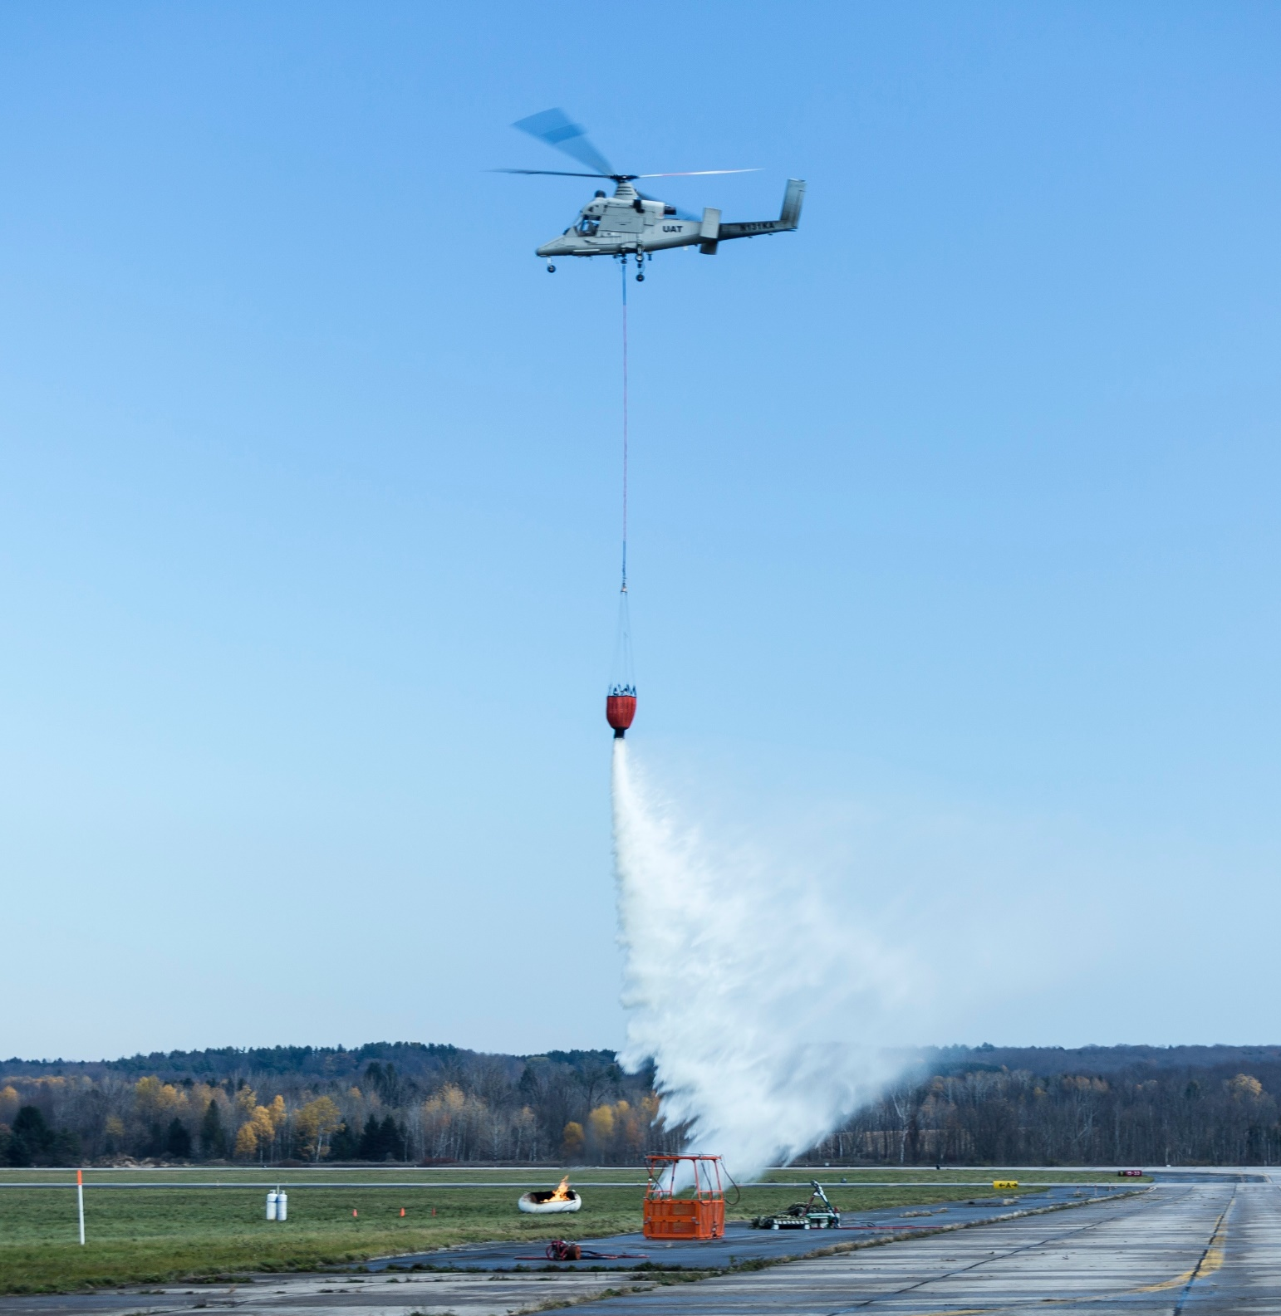
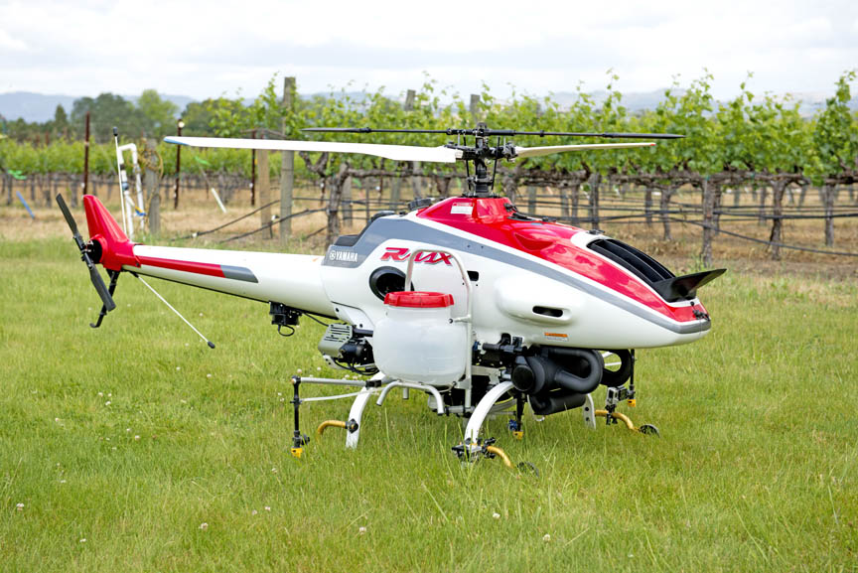
Kmax, Rmax, Nebraska Drone

Slide 12





The Future?

Slide 13
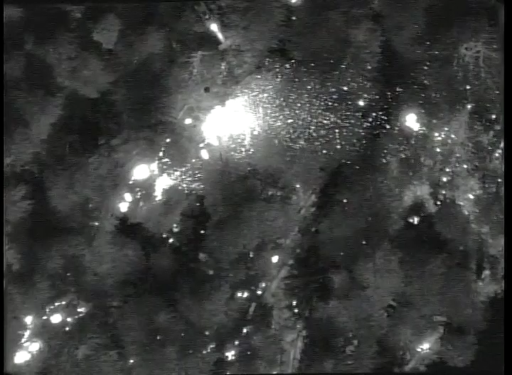
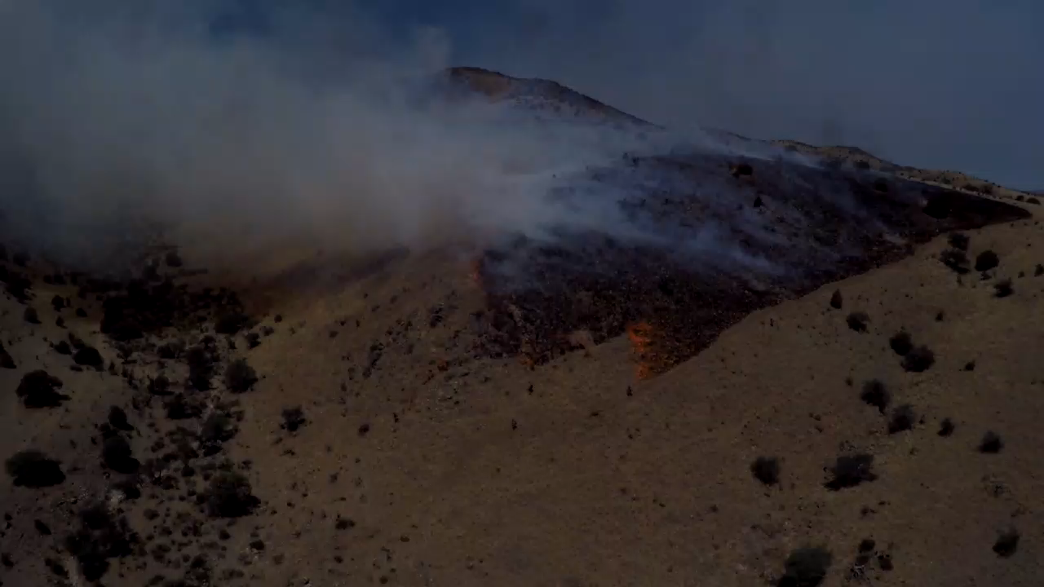
Other Risk Reduction Missions
Wildland Fire Support
  Fire Recon and Mapping
Notes:
Other missions where we can reduce risk to firefighters and aircraft:
Wildland fire support
Fire Recon
Mapping

Slide 14
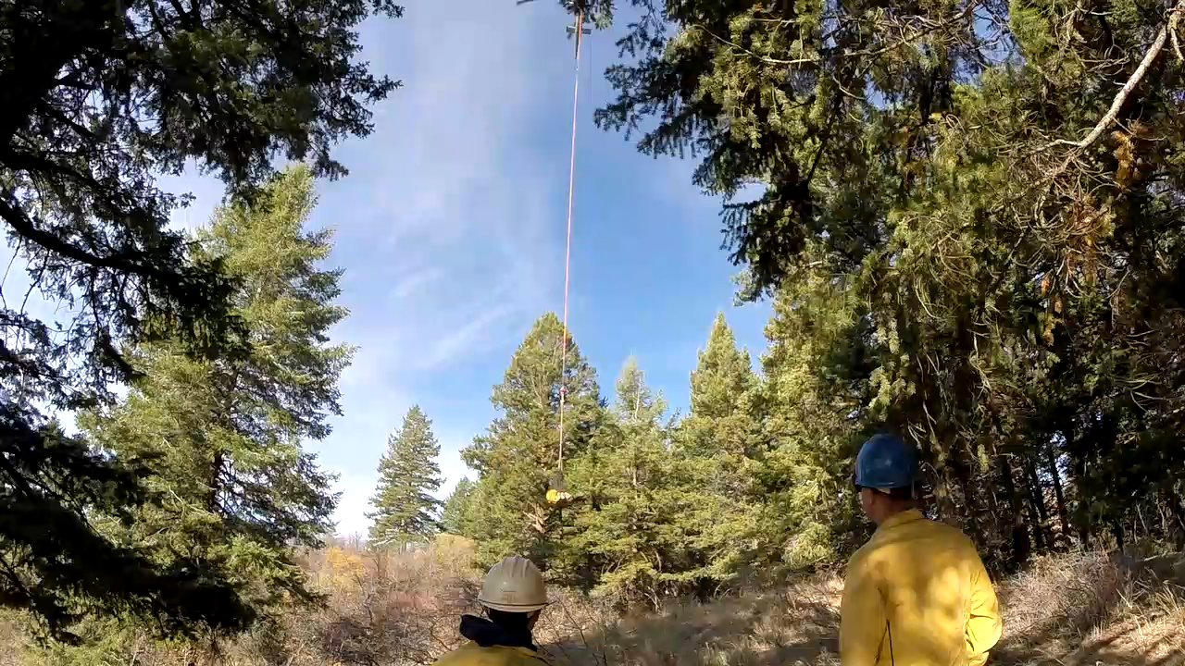
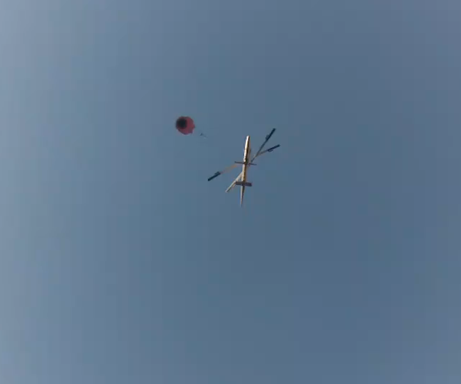
Optionally Piloted Aircraft
Cargo Hauling
Water Drops
Notes:
Cargo hauling
Water drops

Slide 15
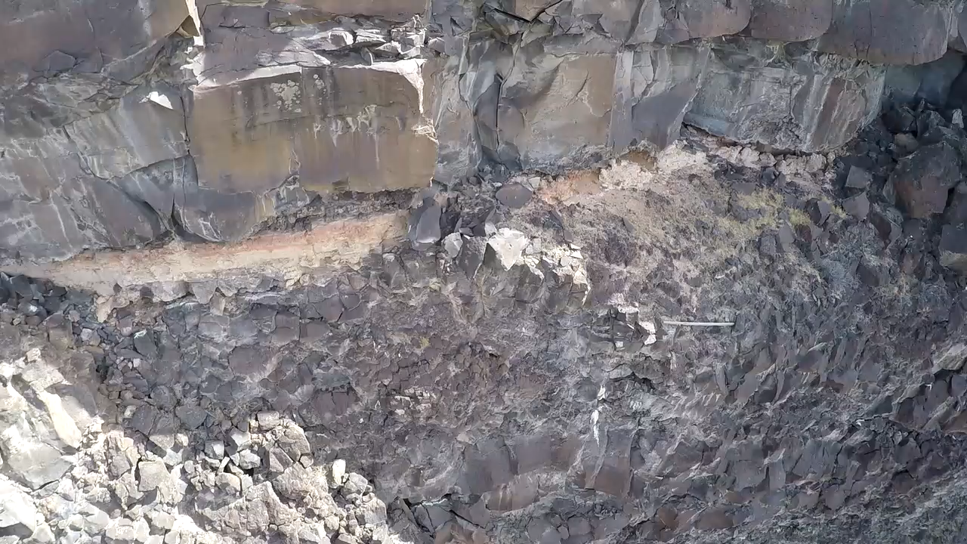
Search and Rescue
Notes:
Search and Rescue operations

Slide 16
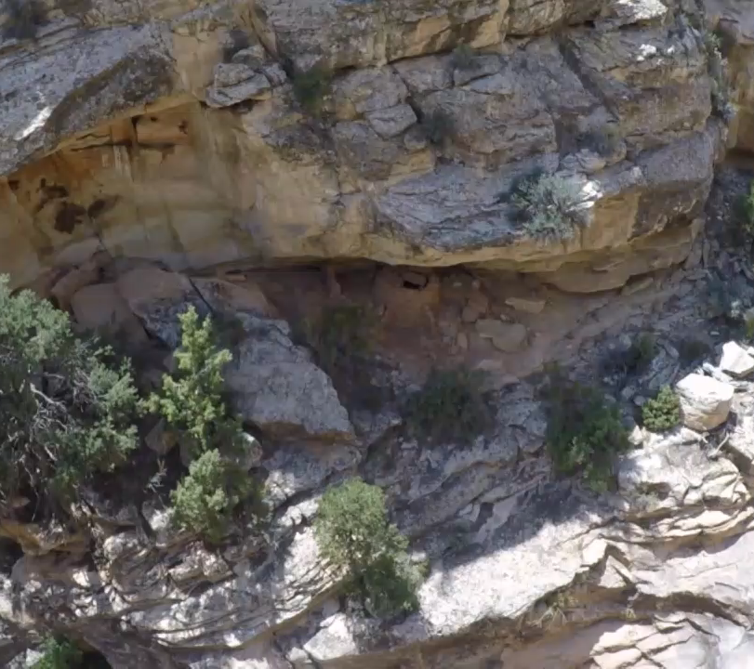
Natural Resource Management
Notes:
Other natural resource management missions
Wildlife surveys/tagging/monitoring
Ecosystem monitor
Sandbar mapping
Coal mine inspections
Surface mining inspections
Etc.

Slide 17

The Next Evolution?
Virtual & Augmented Reality
Video Courtesy of Insitu

Slide 18
Future Predictions
Seamless Airborne Connectivity
Air Robotics
Ground Robotics
Augmented and Virtual Reality
In Your Hand; On Demand
Photo Courtesy of Insitu
Notes:
Future Predictions
Wildland firefighting – possible to provide 24/7 support to our ground firefighters, game changer
Air Robotics – we talked about over 40 fatalities in the span of 10 years—way too high cost of doing business, lends us an opportunity to reduce risk/save lives
Ground Robotics – on average at least 1 dozer accident occurs on a fire each year, result is either seriously or fatally injured, option could reduce those risks/save lives
Augmented and Virtual Reality -
In you hand; on demand -

Slide 19
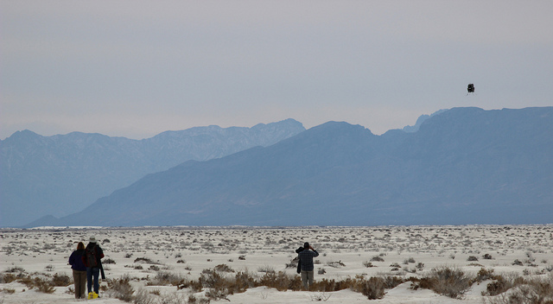
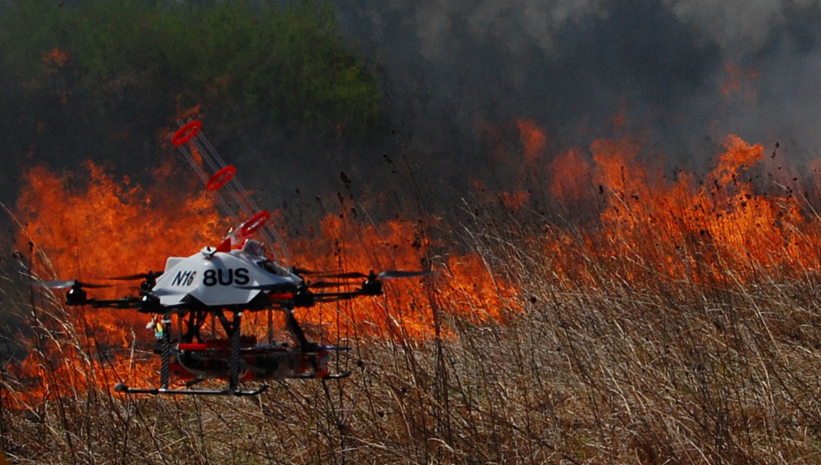
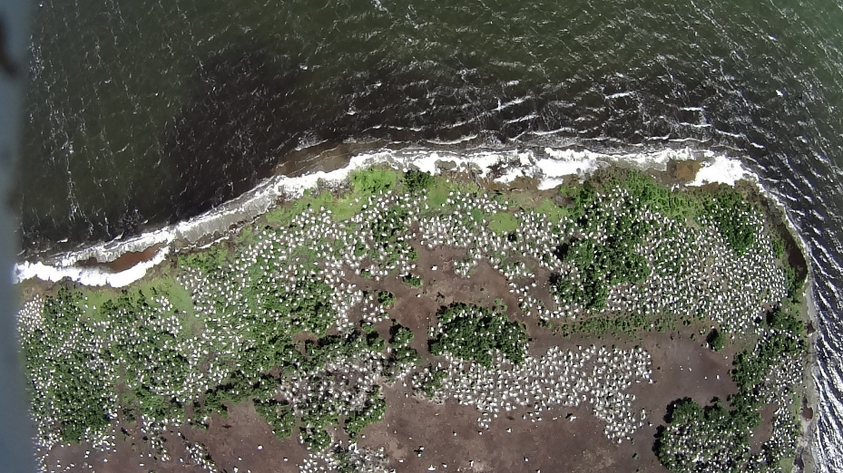

Questions & Discussion
Mark Bathrick
Director, Office of Aviation Services
U.S. Department of the Interior
Mark_bathrick@ios.doi.gov

